Slide 1
Introduction to Different Phases of Compiler

Slide 2
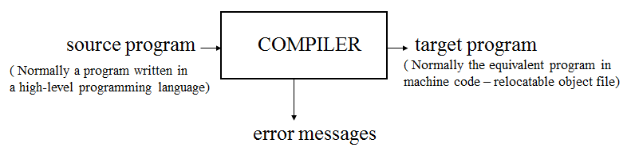
Compiler
A compiler is a program that reads a program in one language (the source language) and translate it into an equivalent program in another language (the target language)
An important role of the compiler is to report any errors in the source program that it detects during the translation process.

Slide 3
Compiler
A compiler is a software that
translates the code written in one language to some other language
without changing the meaning of the program.

Slide 4
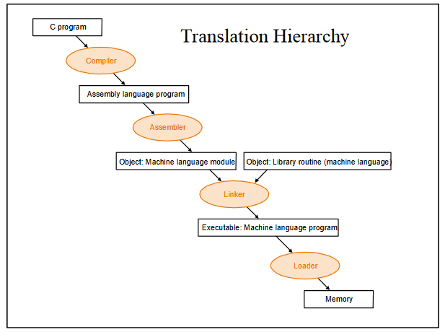
Compiler
The compiler is also said to
make the target code efficient and
optimized in terms of time and space.
In this example , “C” compiler converts high-level language program into assembly language

Slide 5
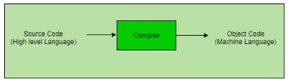
Compiler
The language processor that reads the complete source program written in high level language as a whole in one go and translates it into an equivalent program in machine language is called as a Compiler.

Slide 6
Compiler
In a compiler, the source code is translated to object code successfully if it is free of errors.
The compiler specifies
the errors at the end of compilation with line numbers when there are any errors in the source code.
The errors must be removed before the compiler can successfully recompile the source code again.

Slide 7
Interpreter
An interpreter, like a compiler, translates high-level language into low-level machine language.

Slide 8
Interpreter
The difference lies in the way they read the source code or input.
A compiler reads the whole source code at once, creates tokens, checks semantics, generates intermediate code, executes the whole program and may involve many passes.
An interpreter reads a statement from the input, executes it, then takes the next statement in sequence.

Slide 9
Interpreter
If an error occurs,
an interpreter stops execution and reports it. The interpreter moves on to the next line for execution only after removal of the error.
whereas a compiler reads the whole program even if it encounters several errors.
Example: Perl, Python and Matlab.

Slide 10
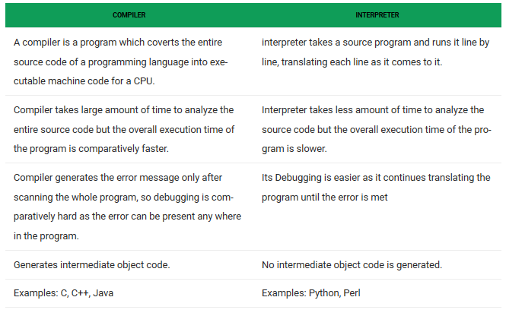

Slide 11
Major Parts of Compilers
There are two major parts of a compiler:
Analysis
Synthesis

Slide 12
Major Parts of Compilers
In analysis phase-
Breaks up the source program into constituent pieces and imposes a grammatical structure on them
Then Uses this grammatical structure to create an intermediate representation of the source program.

Slide 13
Major Parts of Compilers
In analysis phase-
If the analysis part detects that the source program is either syntactically ill formed or semantically unsound, then it must provide informative messages, so the user can take corrective action.

Slide 14
Major Parts of Compilers
In analysis phase-
The analysis part also collects information about the source program and stores it in a data structure called a symbol table, which is passed along with the intermediate representation to the synthesis part.
Lexical Analyzer, Syntax Analyzer and Semantic Analyzer are the parts of this phase.

Slide 15
Major Parts of Compilers
In synthesis phase-
The synthesis part constructs the desired target program from the intermediate representation and the information in the symbol table.
The equivalent target program is created from this intermediate representation.
Intermediate Code Generator, Code Generator, and Code Optimizer are the parts of this phase.

Slide 16
Major Parts of Compilers
The analysis part is often called the front end of the compiler; the synthesis part is the back end.
If we examine the compilation process in more detail, we see that it operates as a sequence of phases,
Each of which transforms one representation of the source program to another

Slide 17
Major Parts of Compilers
The symbol table, which stores information about the entire source program, is used by all phases of the compiler.

Slide 18
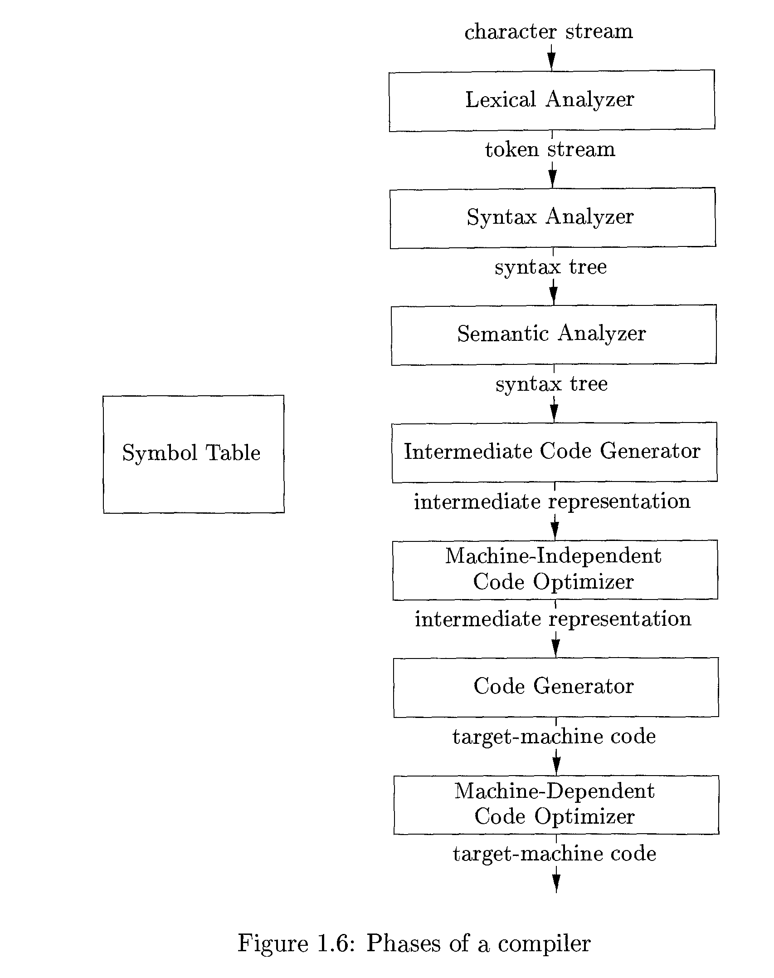
Phases of compilers
A typical decomposition of a compiler into phases

Slide 19
Phases of A Compiler
Source
Program
Lexical
Analyzer
Syntax
Analyzer
Semantic
Analyzer
Intermediate
Code Generator
Code
Optimizer
Code
Generator
Target
Program
Each phase transforms the source program from one representation
into another representation.
They communicate with error handlers.
They communicate with the symbol table.

Slide 20
Lexical Analyzer
The first phase of a compiler is called lexical analysis or scanning.
The lexical analyzer reads the stream of characters making up the source program and groups the characters into meaningful sequences called lexemes.

Slide 21
Lexical Analyzer
For each lexeme, the lexical analyzer produces as output a token of the form
<token-name; attribute-value>
that it passes on to the subsequent phase, syntax analysis.

Slide 22
Lexical Analyzer
<token-name; attribute-value>
In the token, the first component token-name is an abstract symbol that is used during syntax analysis,
The second component attribute-value points to an entry in the symbol table for this token.
Information from the symbol-table entry is needed for semantic analysis and code generation.

Slide 23
Lexical Analyzer
A token describes a pattern of characters having same meaning in the source program. (such as identifiers, operators, keywords, numbers, delimeters and so on)

Slide 24
Lexical Analyzer
For example, suppose a source program contains the assignment statement
position = initial + rate * 60
The characters in this assignment could be grouped into lexemes and mapped into tokens passed on to the syntax analyzer

Slide 25
Lexical Analyzer
position = initial + rate * 60
position is a lexeme that would be mapped into a token <id,1>,
where id is an abstract symbol standing for identifier and
1 points to the symbol-table entry for position.
The symbol-table entry for an identifier holds information about the identifier, such as its name and type.

Slide 26
Lexical Analyzer
position = initial + rate * 60
The assignment symbol = is a lexeme that is mapped into the token < = >
Since this token needs no attribute-value, we have omitted the second component.
We could have used any abstract symbol such as assign for the token-name, but for notational convenience we have chosen to use the lexeme itself as the name of the abstract symbol.

Slide 27
Lexical Analyzer
position = initial + rate * 60
initial is a lexeme that is mapped into the token <id, 2>,
where 2 points to the symbol-table entry for initial.
+ is a lexeme that is mapped into the token <+>
rate is a lexeme that is mapped into the token <id, 3>,
where 3 points to the symbol-table entry for rate.

Slide 28
Lexical Analyzer
position = initial + rate * 60
* is a lexeme that is mapped into the token <*>
60 is a lexeme that is mapped into the token <60>
Blanks separating the lexemes would be discarded by the lexical analyzer.

Slide 29
Lexical Analyzer
position = initial + rate * 60
the representation of the assignment statement after lexical analysis as the sequence of tokens
<id,1> < = > <id, 2> <+> <id, 3><*><60>
In this representation, the token names =, +, and * are abstract symbols for the assignment, addition, and multiplication operators, respectively.

Slide 30
Lexical Analyzer
Puts information about identifiers into the symbol table.
Regular expressions are used to describe tokens (lexical constructs).
A (Deterministic) Finite State Automaton can be used in the implementation of a lexical analyzer.

Slide 31
Syntax Analyzer
The second phase of the compiler is syntax analysis or parsing.
The parser uses the tokens produced by the lexical analyzer to create a tree-like intermediate representation that depicts the grammatical structure of the token stream.

Slide 32

Syntax Analyzer
A syntax tree for the token stream is:
A typical representation is a syntax tree in which each interior node represents an operation and the children of the node represent the arguments of the operation.

Slide 33
Parsing Techniques
Depending on how the parse tree is created, there are different parsing techniques.
These parsing techniques are categorized into two groups:
Top-Down Parsing,
Bottom-Up Parsing

Slide 34
Parsing Techniques
Top-Down Parsing:
Construction of the parse tree starts at the root, and proceeds towards the leaves.
Efficient top-down parsers can be easily constructed by hand.
Recursive Predictive Parsing, Non-Recursive Predictive Parsing (LL Parsing).

Slide 35
Parsing Techniques
Bottom-Up Parsing:
Construction of the parse tree starts at the leaves, and proceeds towards the root.
Normally efficient bottom-up parsers are created with the help of some software tools.
Bottom-up parsing is also known as shift-reduce parsing.
Operator-Precedence Parsing – simple, restrictive, easy to implement
LR Parsing – much general form of shift-reduce parsing, LR, SLR, LALR

Slide 36
Semantic Analyzer
Semantics (from Ancient Greek: sēmantikós, "significant")
Is the study of reference, meaning, or truth.
In computer science, the term semantics refers to the meaning of language constructs, as opposed to their form (syntax).

Slide 37
Semantic Analyzer
A semantic analyzer checks the source program for semantic errors and gathers the type information for the subsequent code generation phase.
Type-checking is an important part of semantic analyzer.
In type checking, the compiler checks that each operator has matching operands.

Slide 38
Semantic Analyzer
For example,
Many programming language definitions require an array index to be an integer;
The compiler must report an error if a floating-point number is used to index an array.

Slide 39
Semantic Analyzer
The language specification may permit some type conversions called coercions.
For example, a binary arithmetic operator may be applied to either a pair of integers or to a pair of floating-point numbers.
If the operator is applied to a floating-point number and an integer, the compiler may convert or coerce the integer into a floating-point number

Slide 40
Semantic Analyzer
For the assignment statement
position = initial + rate * 60
Suppose that position, initial, and rate have been declared to be floating-point numbers, and that the lexeme 60 by itself forms an integer.

Slide 41
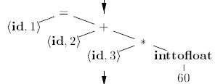
Semantic Analyzer
For the assignment statement
position = initial + rate * 60
The type checker in the semantic analyzer discovers that the operator * is applied to a floating-point number rate and an integer 60.
In this case, the integer may be converted into a floating-point number.

Slide 42
Semantic Analyzer
For the assignment statement
position = initial + rate * 60
The output of the semantic analyzer has an extra node for the operator inttofloat,
which explicitly converts its integer argument into a floating-point number.

Slide 43
Intermediate Code Generation
In the process of translating a source program into target code, a compiler may construct one or more intermediate representations, which can have a variety of forms.
Syntax trees are a form of intermediate representation; they are commonly used during syntax and semantic analysis.

Slide 44
Intermediate Code Generation
After syntax and semantic analysis of the source program, many compilers generate an explicit low-level or machine-like intermediate representation, which we can think of as a program for an abstract machine.
This intermediate representation should have two important properties:
it should be easy to produce and
it should be easy to translate into the target machine.

Slide 45
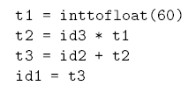
Intermediate Code Generation
The output of the intermediate code generator in Figure consists of the three-address code sequence
<id,1> < = > <id, 2> <+> <id, 3><*><60>

Slide 46
Intermediate Code Generation
An intermediate form called three-address code,
Which consists of a sequence of assembly-like instructions with three operands per instruction.

Slide 47
Intermediate Code Generation
Main points about three-address instructions.
Each three-address assignment instruction has at most one operator on the right side. Thus, these instructions fix the order in which operations are to be done; the multiplication precedes the addition in the source program
The compiler must generate a temporary name to hold the value computed by a three-address instruction.
Some “three-address instructions" like the first and last in the sequence above, have fewer than three operands.

Slide 48
Optimization of Intermediate Code
Some compilers have a machine-independent optimization phase between the front end and the back end.

Slide 49
Optimization of Intermediate Code
The purpose of this optimization phase is :
To perform transformations on the intermediate representation,
so that the back end can produce a better target program than it would have otherwise produced from an unoptimized intermediate representation.

Slide 50
Optimization of Intermediate Code
Since optimization is optional, one or the other of the two optimization phases shown in Fig. may be missing.

Slide 51
Code Optimizer (for Intermediate Code Generator)
The code optimizer optimizes the code produced by the intermediate code generator in the terms of time and space.
The machine-independent code-optimization phase attempts to improve the intermediate code so that better target code will result.
Usually better means faster, but other objectives may be desired, such as shorter code, or target code that consumes less power.

Slide 52

Code Optimizer (for Intermediate Code Generator)
The optimizer can deduce that the conversion of 60 from integer to floating point can be done once and for all at compile time,
So the inttofloat operation can be eliminated by replacing the integer 60 by the floating-point number 60.0.
Moreover, t3 is used only once to transmit its value to id1 so the optimizer can transform (1.3) into the shorter sequence

Slide 53
Code Optimizer (for Intermediate Code Generator)
There is a great variation in the amount of code optimization different compilers perform.
In those that do the most, the so-called “optimizing compilers,“ a significant amount of time is spent on this phase.

Slide 54
Code Generator
The code generator takes as input an intermediate representation of the source program and maps it into the target language.

Slide 55
Code Generator
If the target language is machine code, registers or memory locations are selected for each of the variables used by the program.
Then, the intermediate instructions are translated into sequences of machine instructions that perform the same task.
A crucial aspect of code generation is the judicious assignment of registers to hold variables.

Slide 56
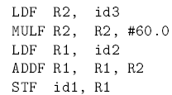
Code Generator
Output of code optimizer-
For example, using registers R1 and R2,
The intermediate code in might get translated into the machine code
The F in each instruction tells us that it deals with floating-point numbers.

Slide 57
Code Generator
The code loads the contents of address id3 into register R2, then multiplies it with floating-point constant 60.0.
The # signifies that 60.0 is to be treated as an immediate constant.
The third instruction moves id2 into register R1
The fourth adds to it the value previously computed in register R2.
Finally, the value in register R1 is stored into the address of id1, so the code correctly implements the source code

Slide 58
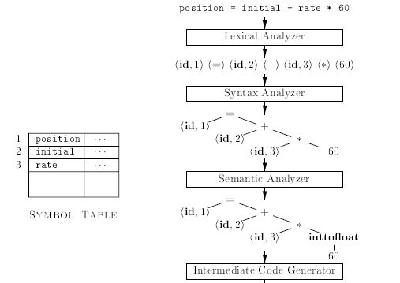
Example Revisited

Slide 59
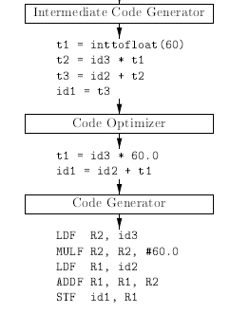
Example Revisited

Slide 60
Symbol-Table Management
An essential function of a compiler is to record the variable names used in the source program and collect information about various attributes of each name.
These attributes may provide information about
the storage allocated for a name,
its type,
its scope (where in the program its value may be used), and
in the case of procedure names, such things as the number and types of its arguments,
the method of passing each argument (for example, by value or by reference), and
the type returned.

